Slide 1


Slide 2
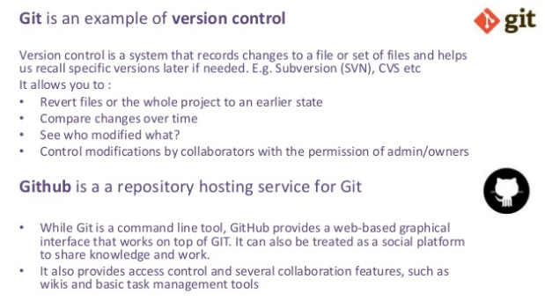
What is Git & Github ?

Slide 3
Repository
Branch
Local repo / remote repo
Commit
Clone
Push
Pull
Pull request

Slide 4


Slide 5
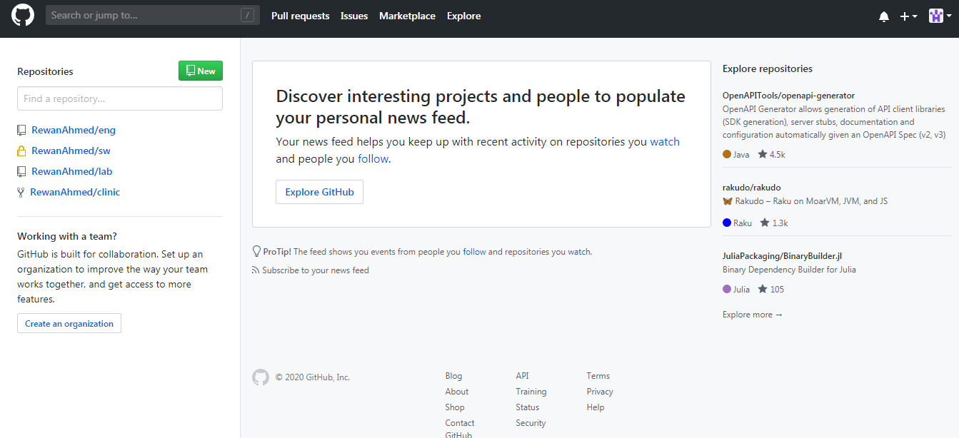

Slide 6
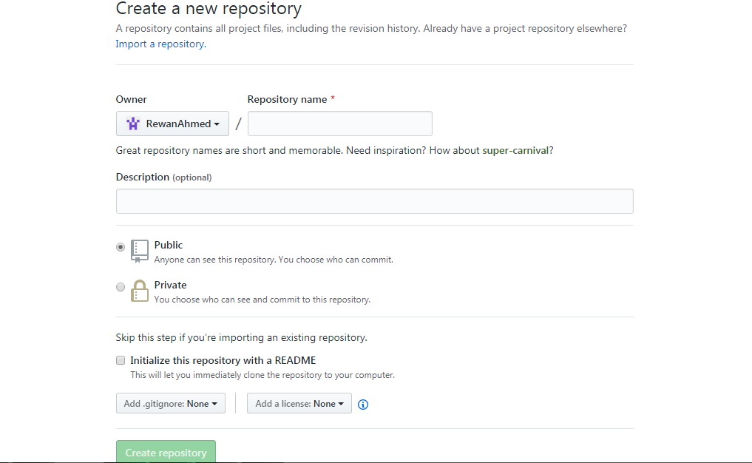

Slide 7
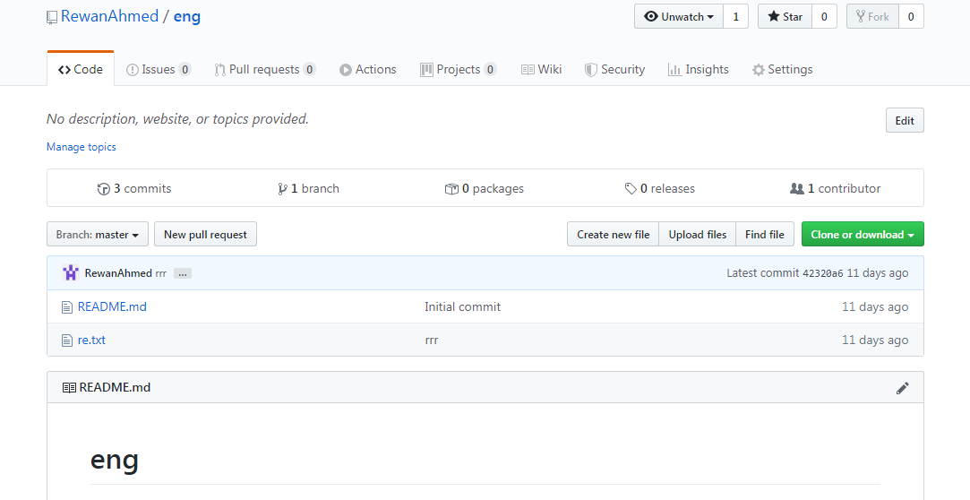

Slide 8
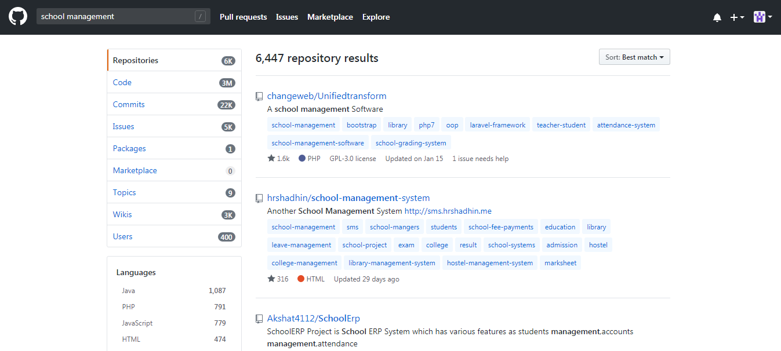

Slide 9
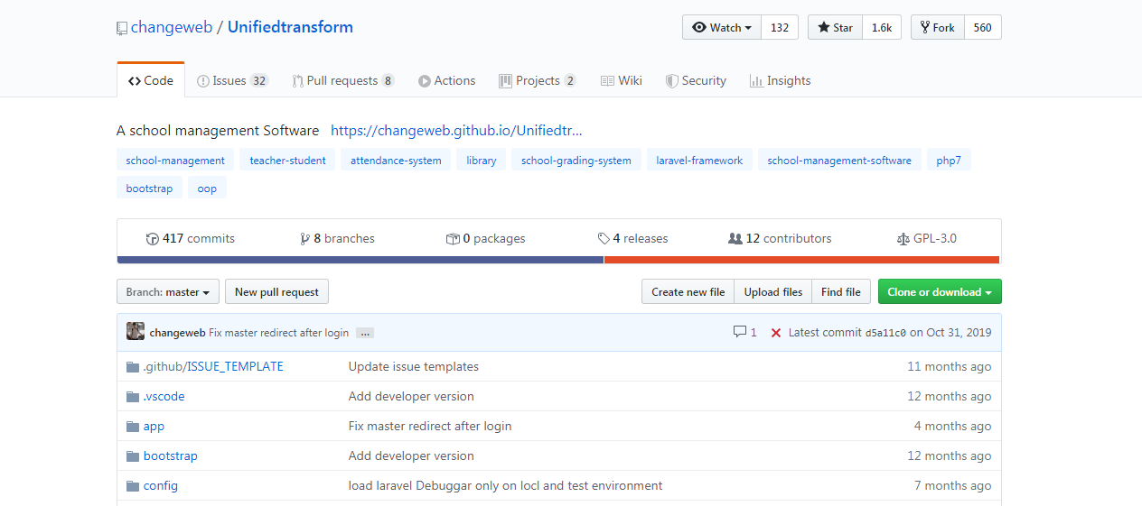

Slide 10
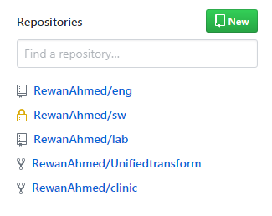

Slide 11
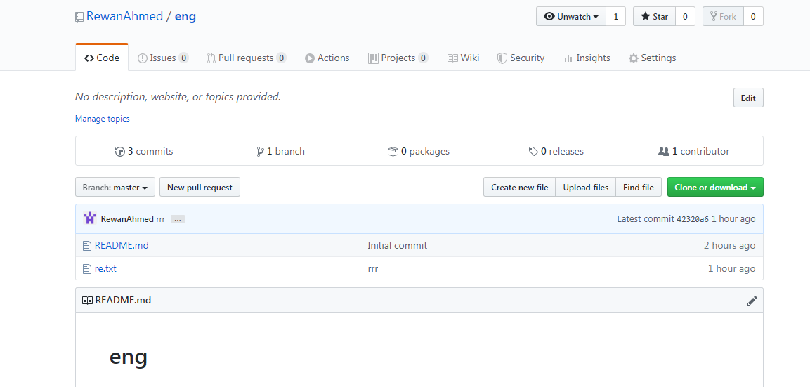

Slide 12
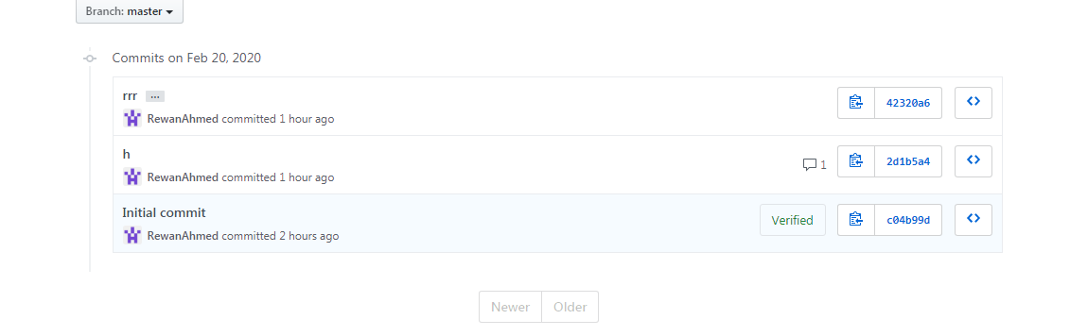

Slide 13
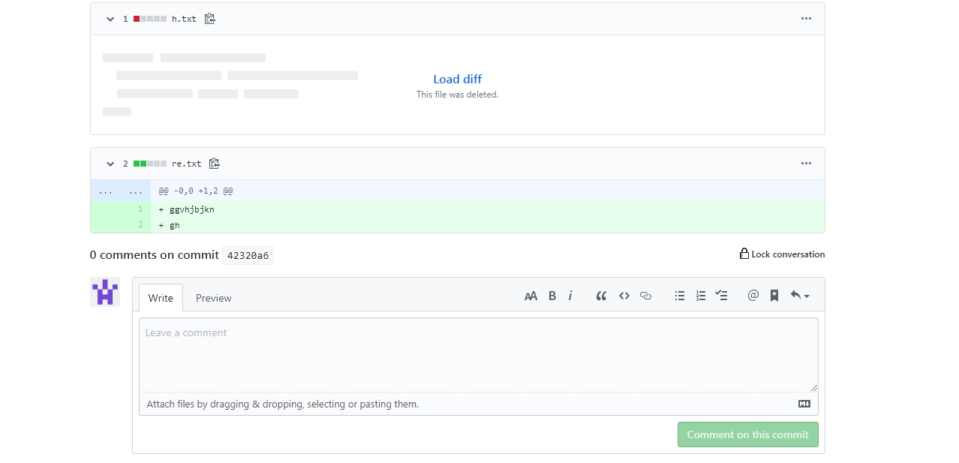

Slide 14
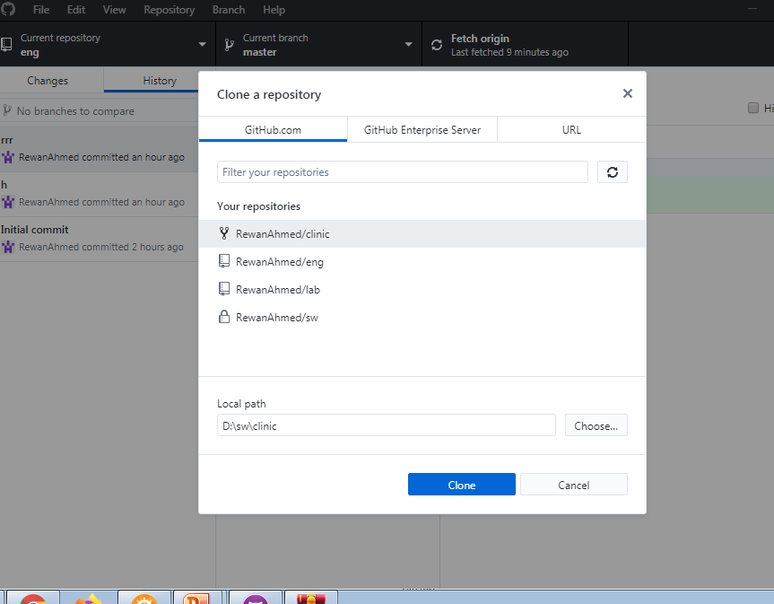

Slide 15
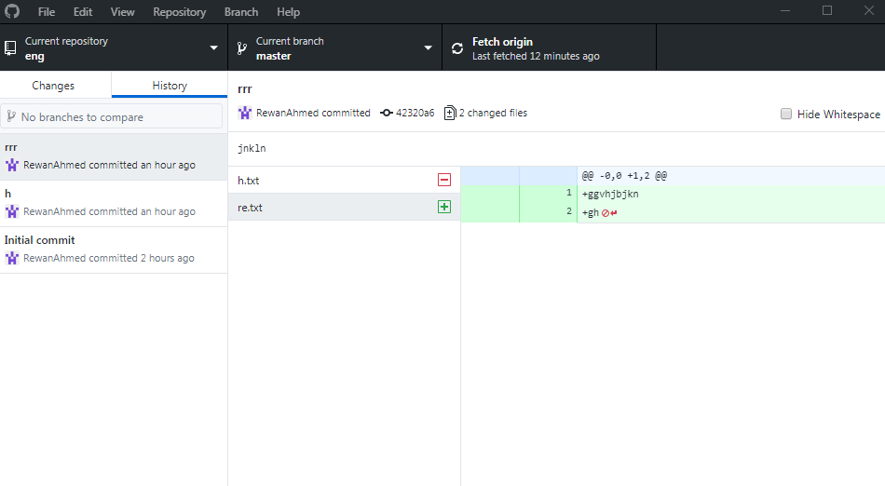

Slide 16
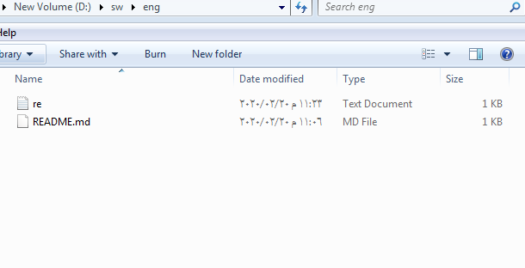

Slide 17
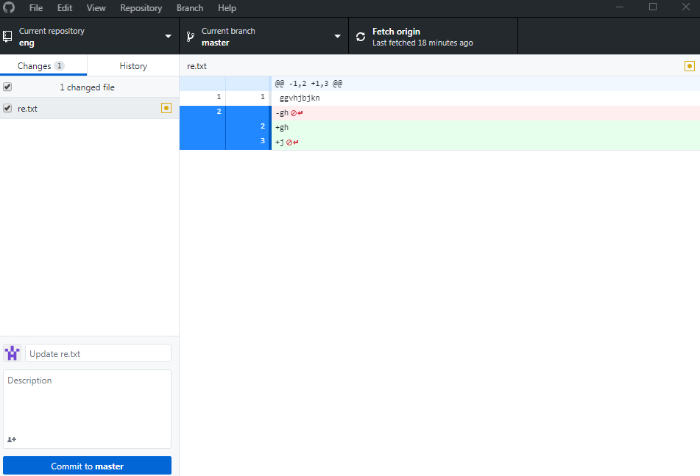

Slide 18
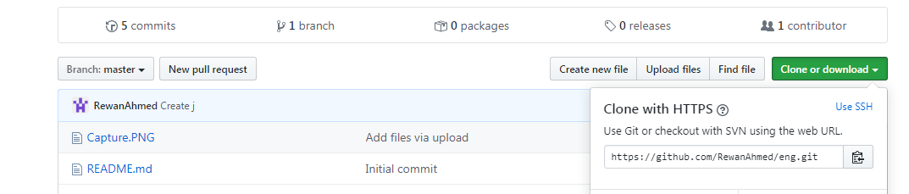

Slide 19
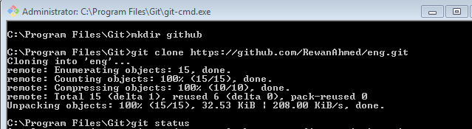
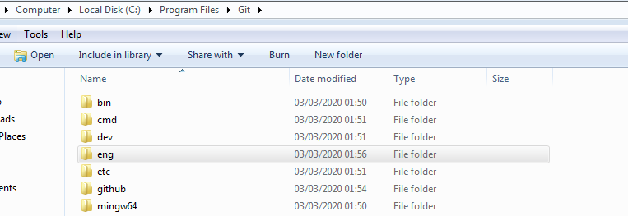

Slide 20
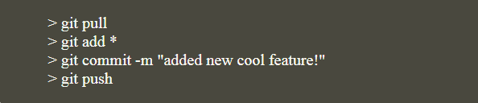
cmd
mkdir name
git init proj.name
git clone link
git status
git add s.txt
git reset s.txt
git branch –d [branch name]
git commit –m “ comment”
git push origin master
Git fetch - git merge))git pull origin

Slide 21
Agile model :
Agile : able to move quickly and easily
Agile model is an iterative development methodology.
What is the advantages and dis-advatages of agile model ?
and How to apply it ?

Slide 22
Functional and non functional requirements
•Functional requirements
Functional requirements help to keep project team going in the right direction.
Unclear requirements leads to a poorly defined scope that creates a lot of challenges from the beginning of the project. A poorly defined scope leads to extension in the schedule and increase in cost.
functional requirements specify a behavior or function
what the system should do ?

Slide 23

What The System Should Do?
describe a particular behavior
for example: “Send email when a new customer signs up” or “Open a new account”.

Slide 24
It can be :
Business Rules
Authentication
Reporting Requirements
Historical Data
Legal or Regulatory Requirements

Slide 25
Functional and non functional requirements
•Non-Functional requirements
how the system works ?
for example: “Modified data in a database should be updated for all users accessing it within 2 seconds.”
Defines system properties and constrains
Reliability , availability , recover from failure , response time , resource usage , reusability , security
Platform :
SW -> os , language , database
HW -> processor , harddisk

Slide 26
Non-Functional Requirements | Functional Requirements
They define the quality attribute of a system | They define a system or its component.
It specifies, “How should the system fulfill the functional requirements?” | It specifies, “What the system should do?”
Non-functional requirement is specified by technical peoples e.g. Architect, Technical leaders and software developers. | User specifies functional requirement.
It is not mandatory to meet these requirements. | It is mandatory to meet these requirements.
Helps you to verify the performance of the software | Helps you to verify the functionality of the software.

Slide 27
Functional Requirements Example:
Authentication of a user when he/she tries to log into the system.
System shutdown in the case of a cyber attack.
Verification email is sent to user whenever he/she registers for the first time on some software system.
Non-functional Requirements Example:
Emails should be sent with a latency of no greater than 12 hours.
Each request should be processed within 10 seconds.
The site should load in 3 seconds when the number of simultaneous users are > 10000

Slide 28
MS project
Project stages
Defining and planning project
Managing the project
Reporting the project

Slide 29
relations
Finish to start
Previous task must finish to start next one
Start to start
Dependent task cant begin until task it depend on begin first
Finish to finish
Task cant be completed utill predecessor task completed fisrt
Start to finish
Dependent task cant be completed until predecessor task started

Slide 30
constrains
Flexible
As late as possible
As soon as possible (default)
Semi-felxible
Start no earlier than
Finish no earlier than
Start no later than
Finish no later than
Inflexible
Must start on
Must finish on

Slide 31
resourses
Work -- people equipment
Material
Cost ( variable – fixed )
----------------------------------------------------------
Critical task
Must be completed on time to avoid any delay
Citical path
Chain of linked critical tasks

